Slide 1
7 WONDERS OF THE USA
Source: https://dayzeroproject.com/man-made-wonders/usa
Szél Anett zsófia

Slide 2
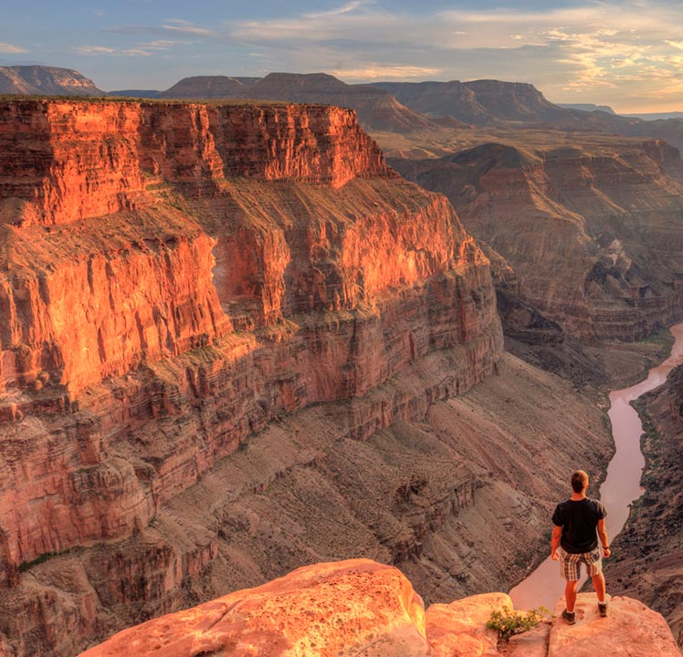
#1 GRAND CANYON
In the state of Arizona
Created by the Colorado River
Natural wonder because of its size
Lookouts
446 kilometers long

Slide 3
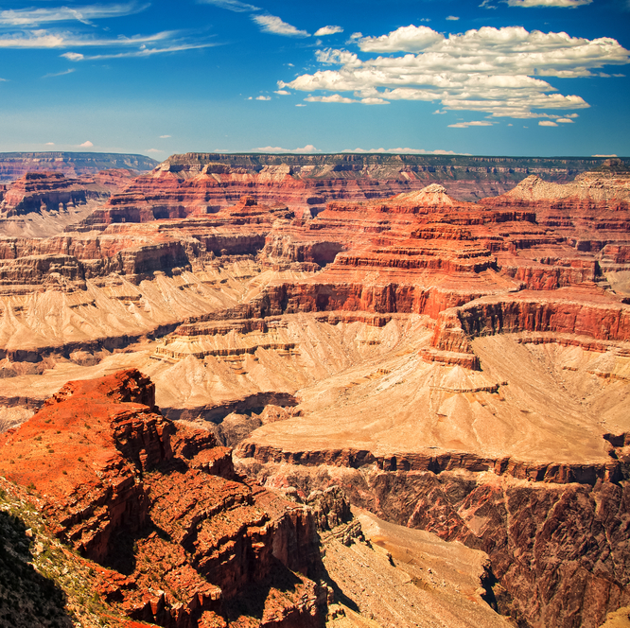
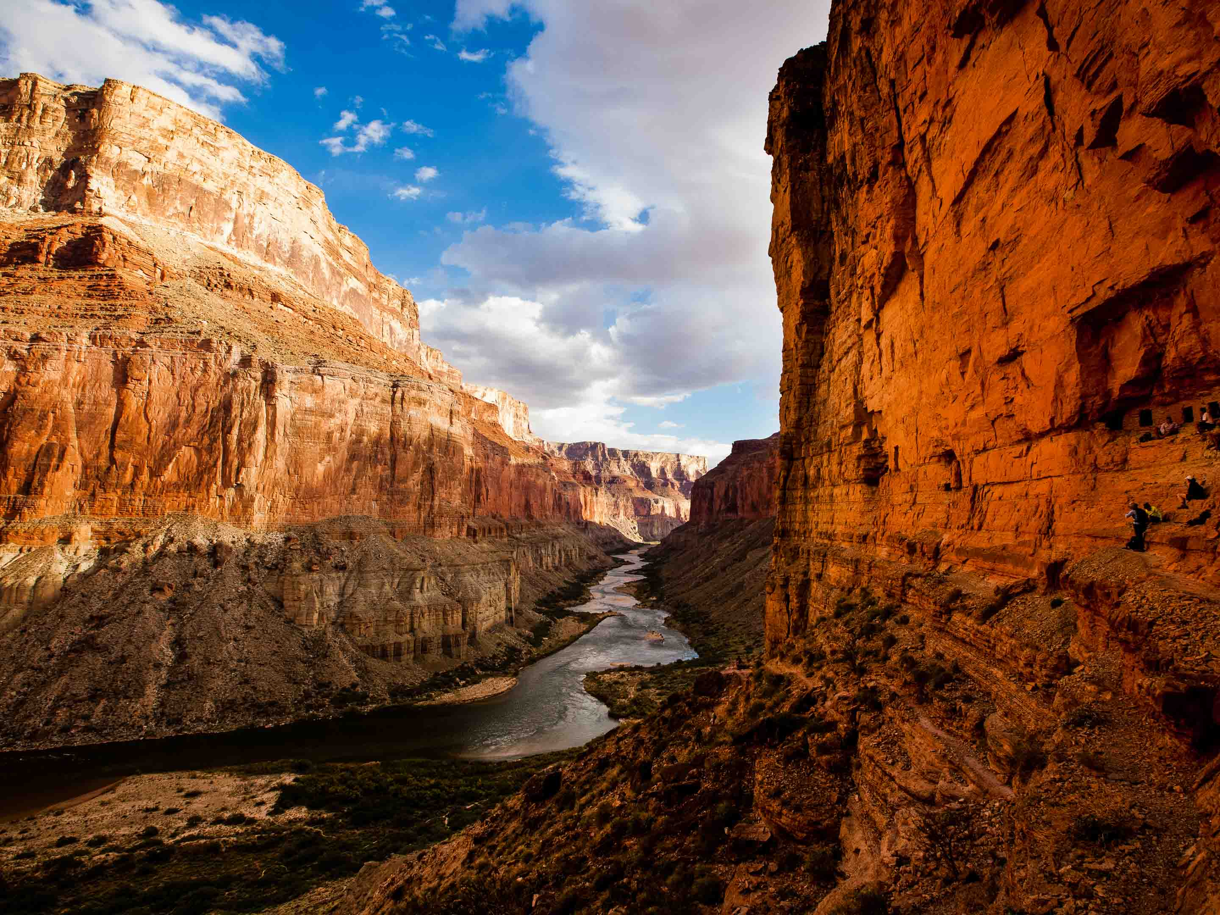

Slide 4
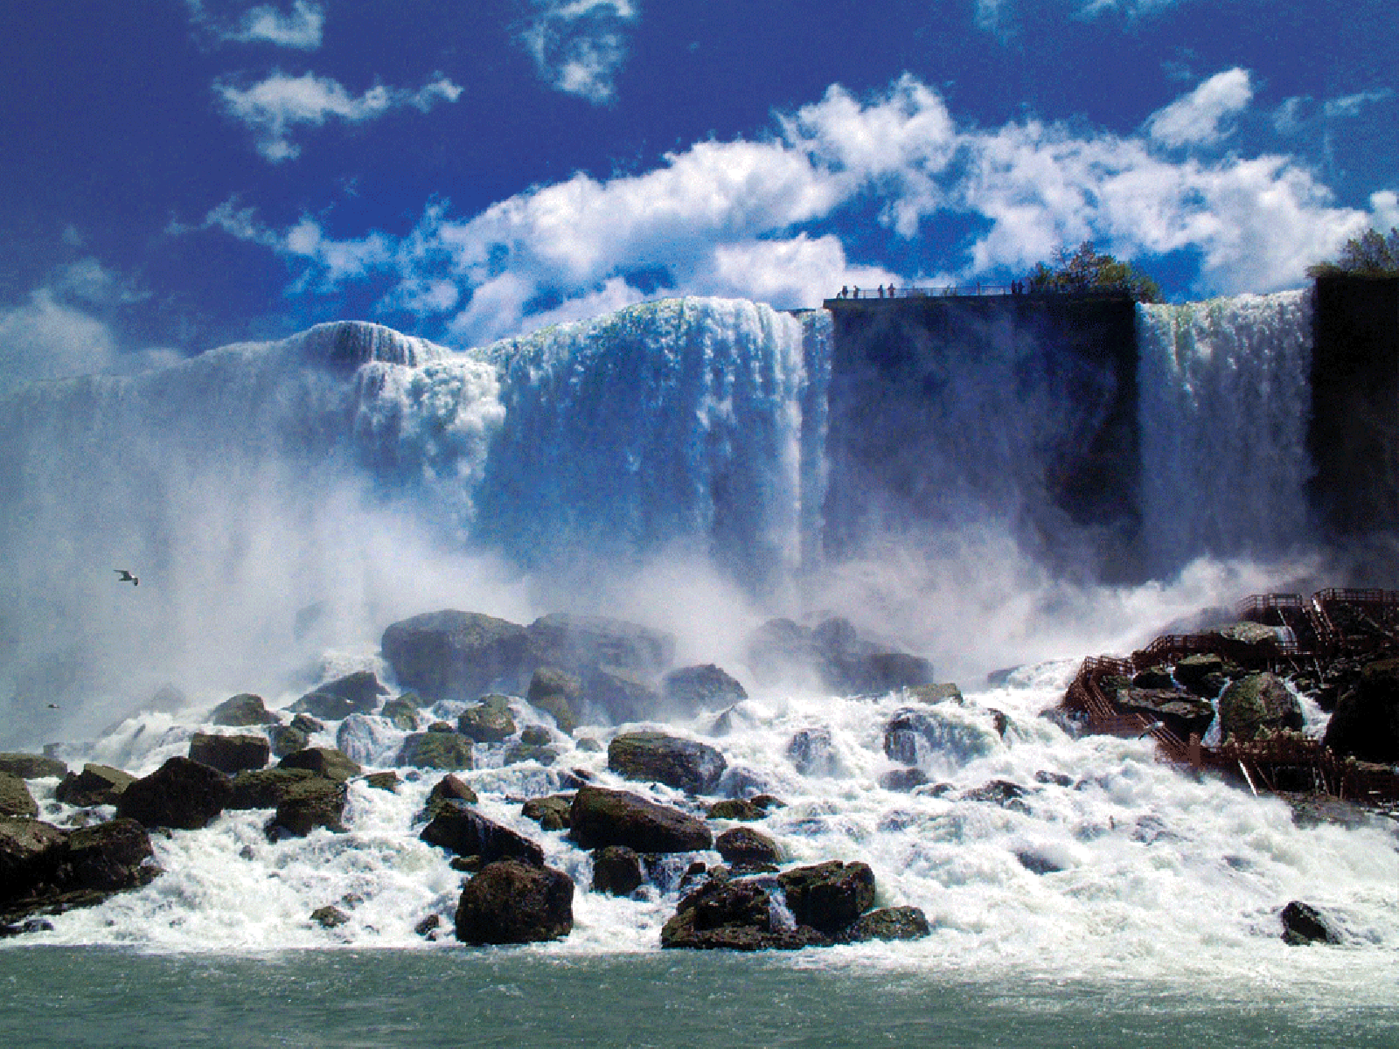
#2 Niagara Falls
Border of Ontario, Canada and NewYork
3 water falls
From the largest to the smallest:
Horseshoe Falls
American Falls
Bridal Veil Falls

Slide 5
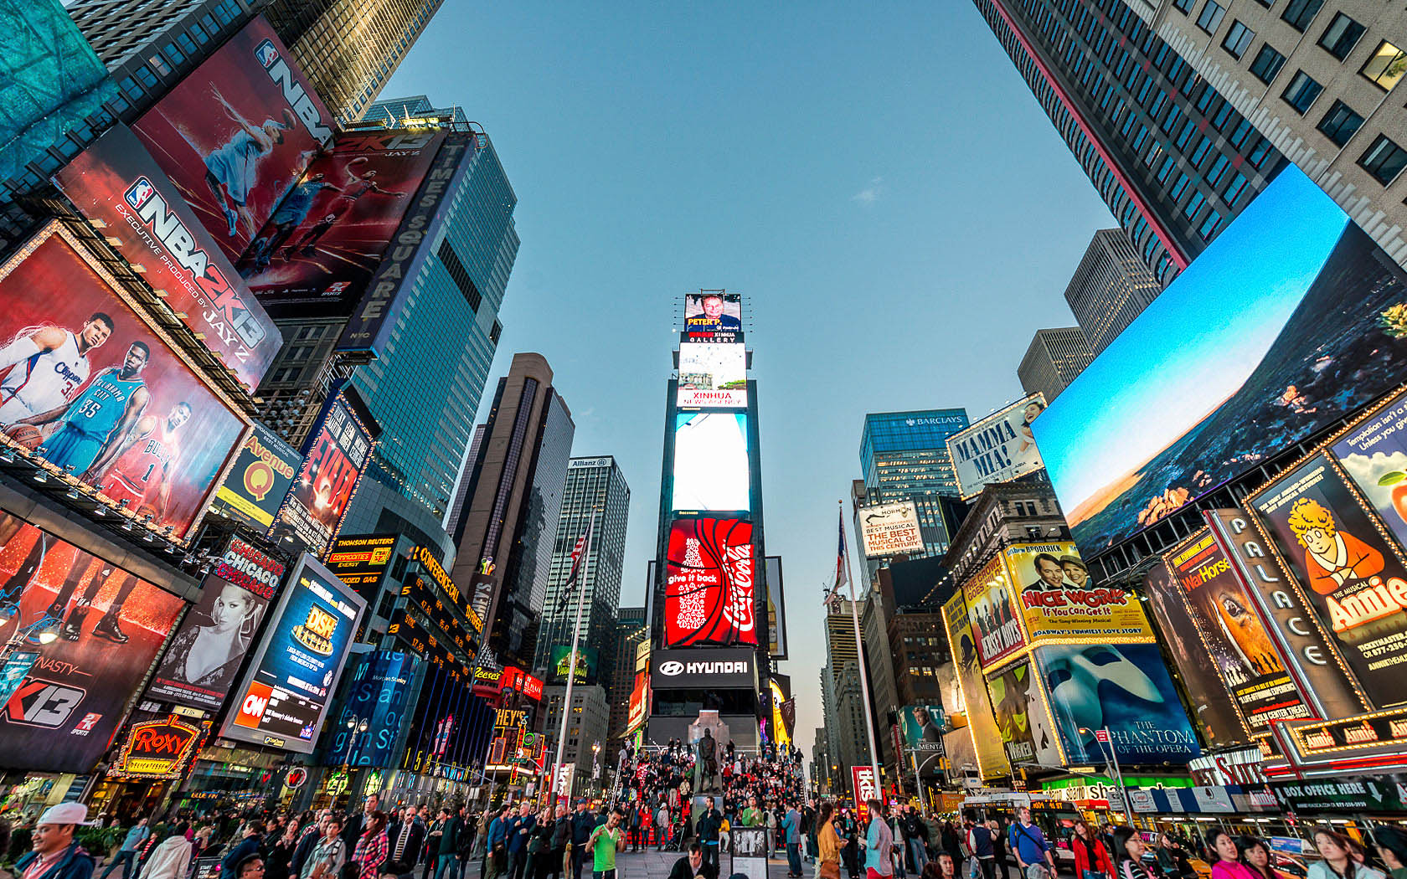
#3 Times square
Major commercial intersection , tourist destination, entertainment center
One of the world’s most visited tourist attraction
About 50 milion visitors annually
Film shooting
Popular on New Year’s Eve

Slide 6
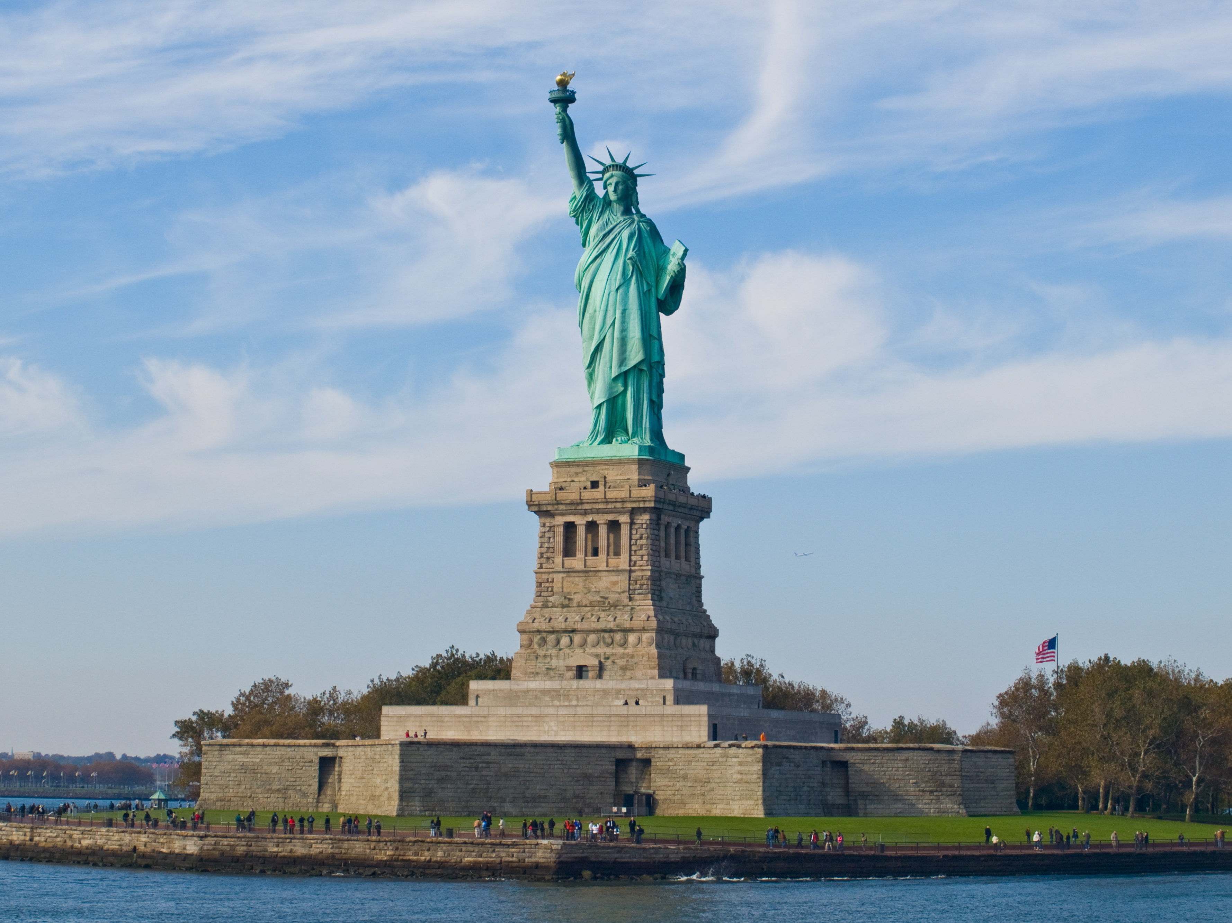
#4 The statue of liberty
Liberty Island in New York Harbor
Gift from France to USA
Designed by Frédéric Auguste Bartholdi
Built by Gustav Eiffel
Dedicated on Oct 28, 1886
93 meters

Slide 7
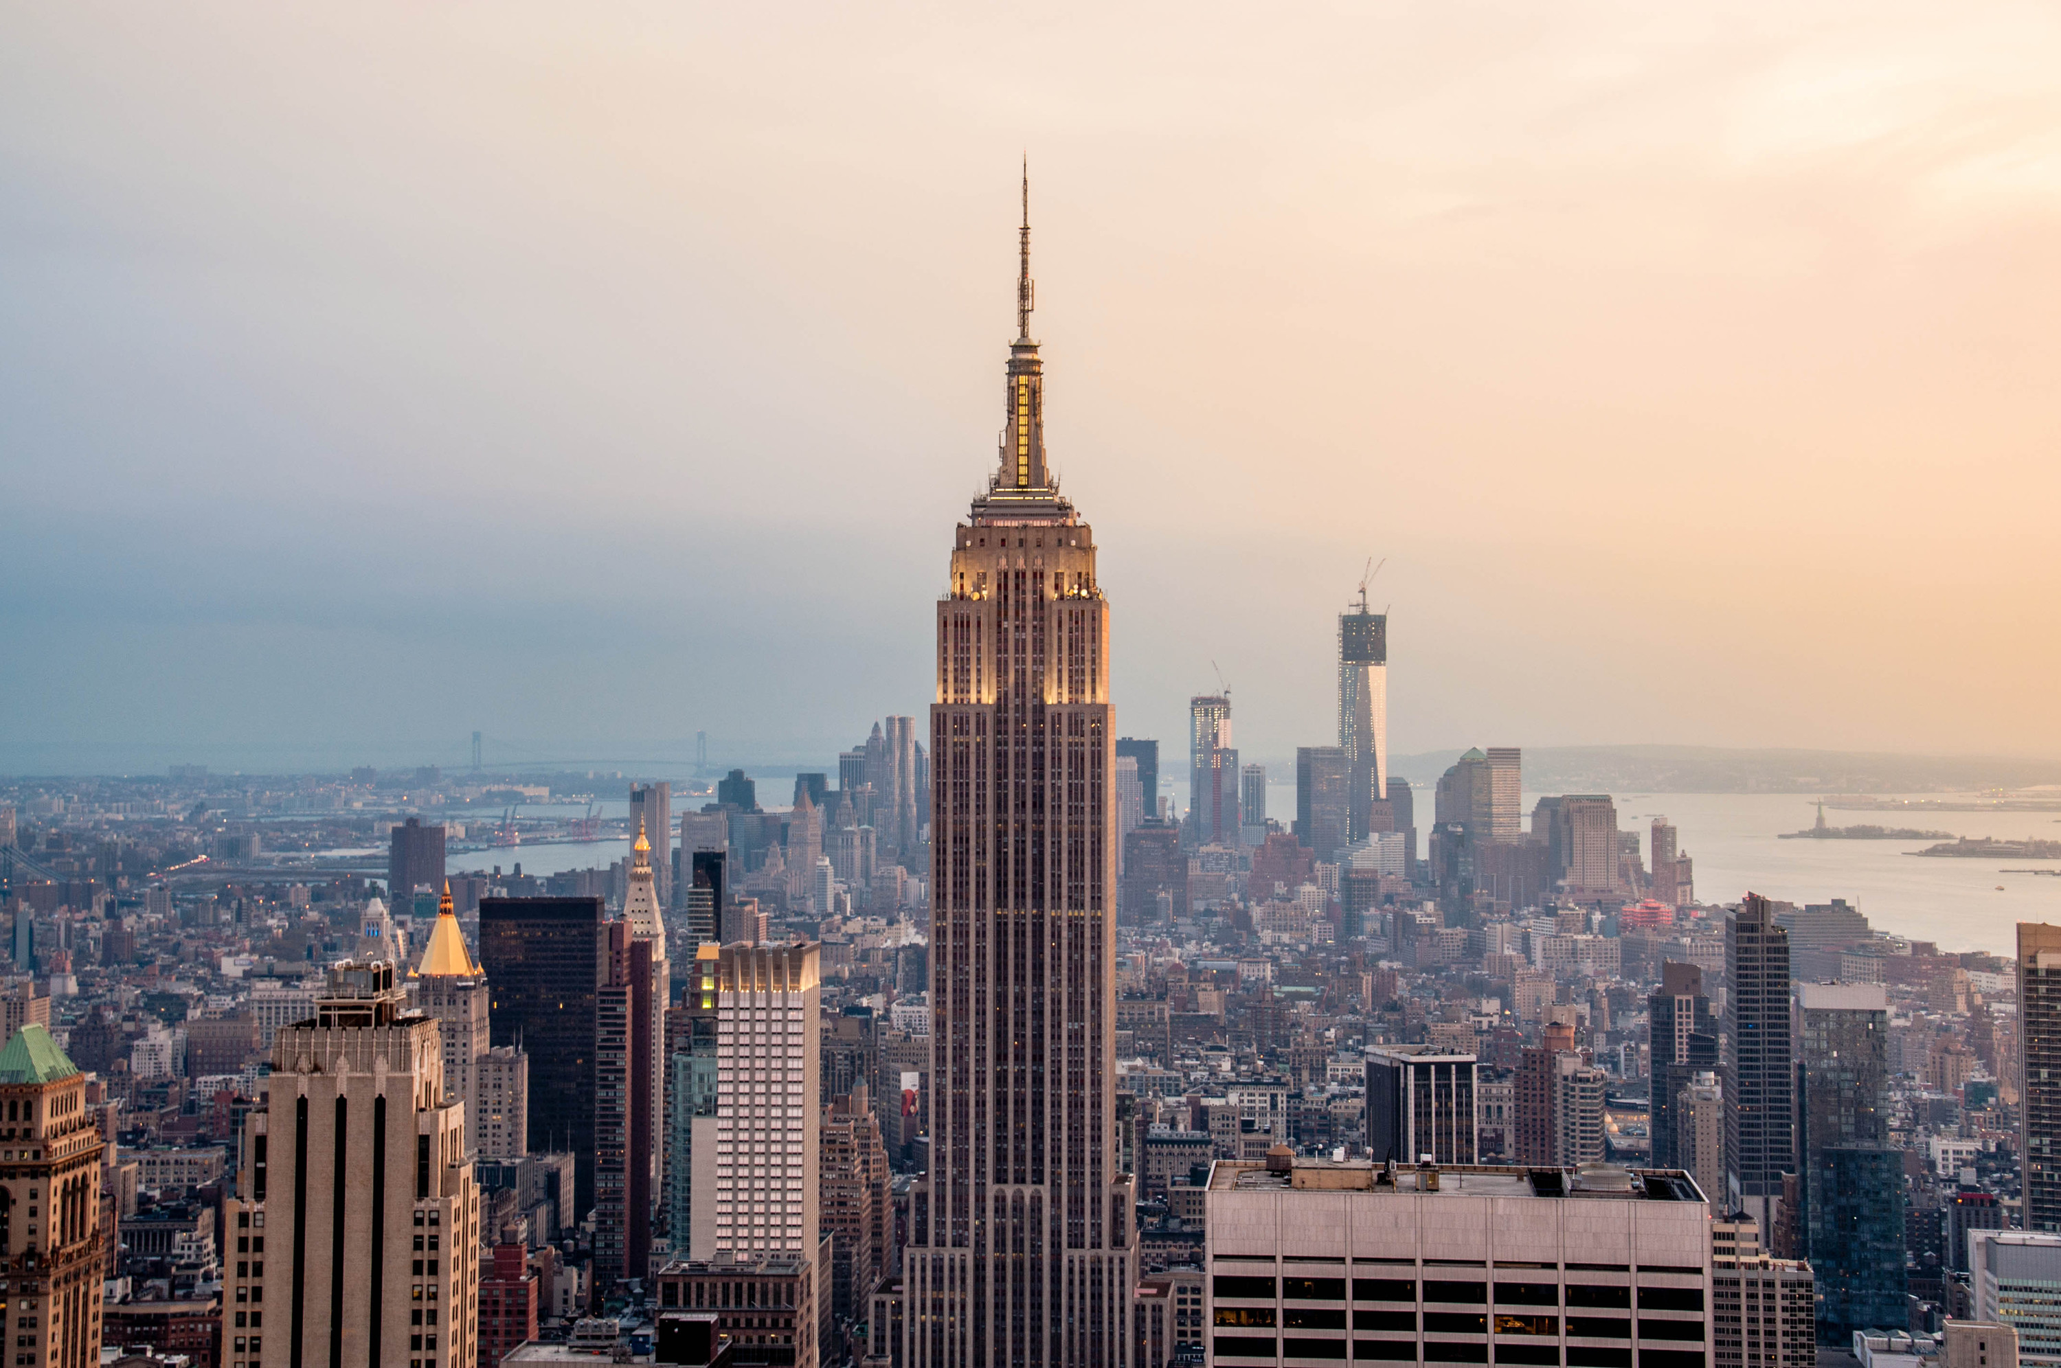
#5 Empire state building
443 meters
Empire State: nickname of New York
Fifth-tallest skycraper in the US, 34th-tallest in the world
American cultural icon
John Jacob Raskob
6500 windows, 1860 steps, 75 lifts

Slide 8
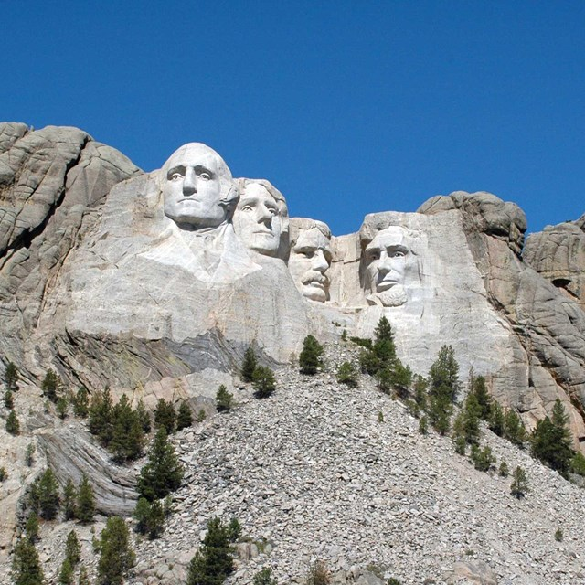
#6 Mount rushmore
Carved into the granit face of Mount Rushmore
Black Hills, Keystone, South Dakota
Sculpted by Gutzon Borglum, Lincoln Borglum
18 meters
Washington, Jefferson, Roosevelt, Lincoln

Slide 9
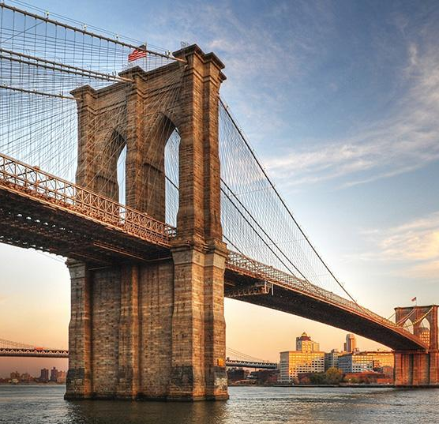
#7 brooklyn bridge
Suspension bridge in New York City
Completed in 1883
Manhattan and Brooklyn
1883 meters
Icon of NYC

