Slide 1
7 wonders of Ireland

Slide 2
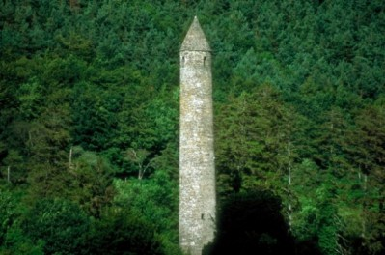
Glendalough
90 minutes south of Dublin city centre in the Wicklow Mountains is the stunning Glendalough.
It flourished for the following 600 years before being ransacked in 1398.

Slide 3
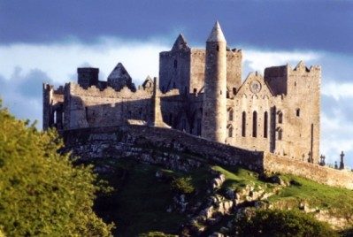
Rock of Cashel
Although little remains of the original buildings, it is believed to be the site where Aenghus, King of Munster, was converted to Christianity by Saint Patrick in the 5th century.

Slide 4
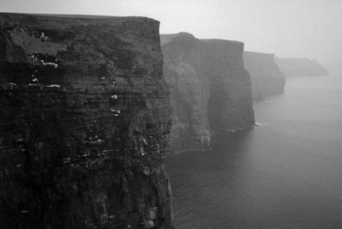
Cliffs of Moher
Step on to the edge of the world and into an awe-inspiring view that dreams are made of – at the Cliffs of Moher you will encounter nature in its wildest, purest form
The cliffs stand up to 214 metres above the Atlantic at one point and run along eight kilometres of the County Clare coastlineA 200 hectare area around the cliffs, both the land and the sea in front of them, is a protected wildlife region.

Slide 5
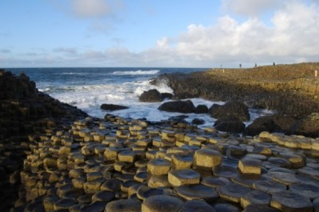
Giant’s causeway
It’s an epic sight, with a whopping 40,000 or so of these octagonal-shaped pillars, which dates back to a volcanic age almost 60 million years ago.

Slide 6
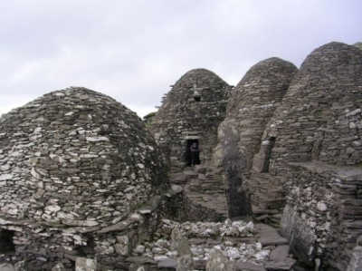
Skellig Islands
The Skellig Islands are impervious to the ever-pounding Atlantic.
The story of the Skellig Islands, 16km west of Bolus Head on the Iveragh Peninsula in County Kerry, began when Christianity arrived in Ireland and they were chosen as a location for one of the first monastic settlements back in the 7th century.

Slide 7
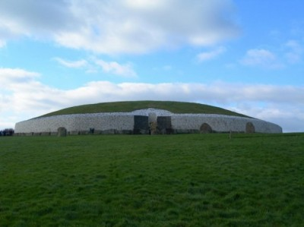
Newgrange
Newgrange is the best known Irish passage tomb and dates to c.3,200BC. The large mound is approximately 80m in diameter and is surrounded at its base by a kerb of 97 stones.

Slide 8
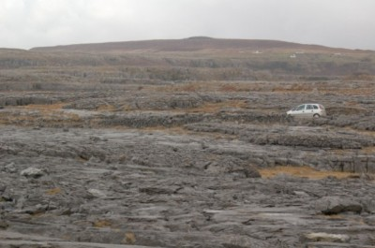
The Burren
The Burren National Park is located in the southeastern corner of the Burren and is approximately 1500 hectares in size

